Slide 1
PARTS Crib database project
(USB BARCODE SCANNER)
Ifeoluwa David Adese

Slide 2
PROJECT DESCRIPTION
The Parts Crib Database project is simply an authentication process for students trying to book out tools and equipment from the college’s parts crib.
We’re basically trying to implement the similar process used at the library desk in borrowing out books and other library materials.
The plan is to generate specific barcode IDs assigned to each student signed up in the parts crib database. IDs could be attached to student cards or anything else.
These barcodes will hold detailed information like Student full name, Student ID, Email Address, Quantity of Items in Possession, List of Items in Possession, User Status i.e. Admin/Student etc.

Slide 3
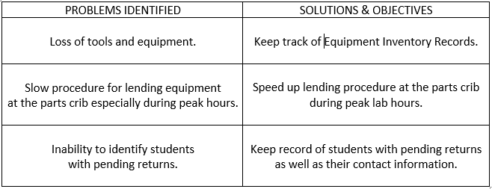
Problems identified & solutions

Slide 4
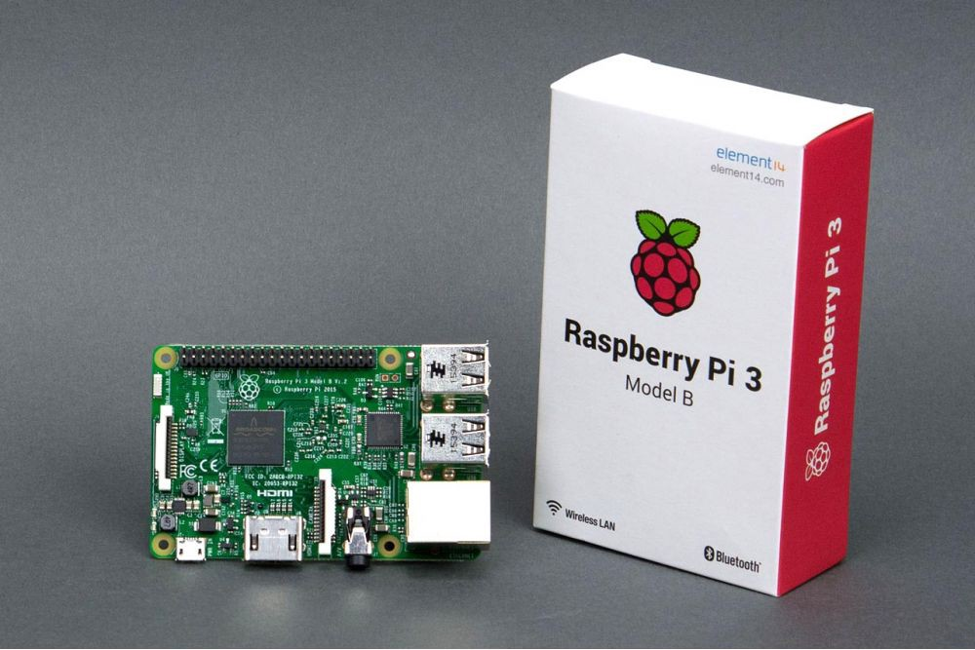
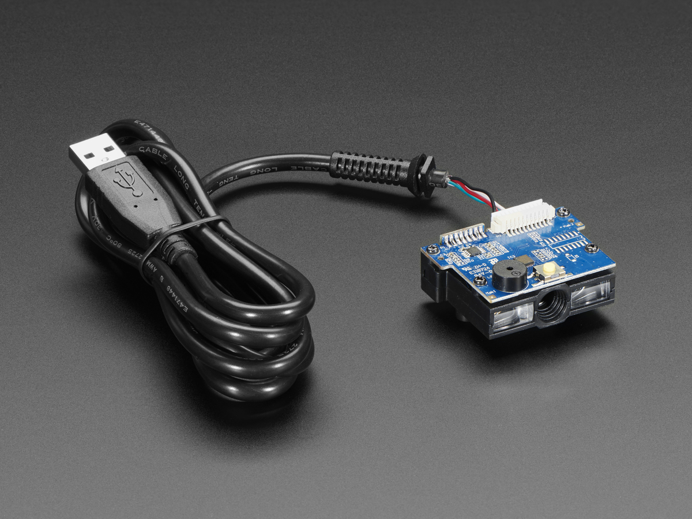
Main required materials & budget
Raspberry Pi 3 Unit - $74.95 (Canakit)
USB Barcode Scanner - $87.52 CAD (Adafruit)

Slide 5
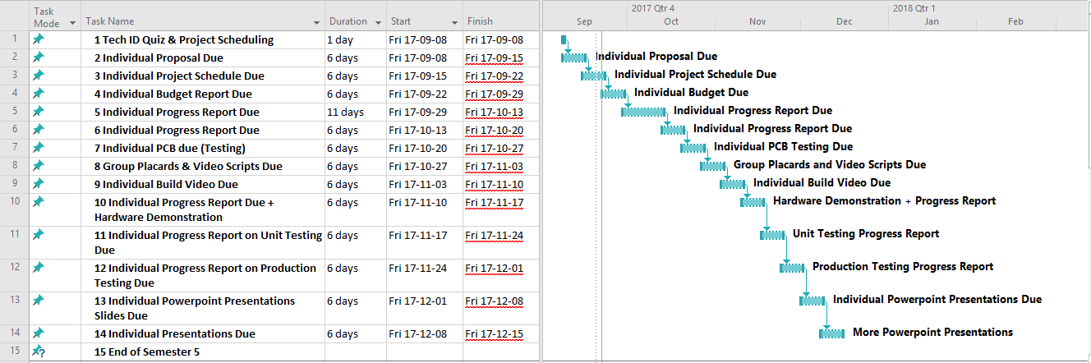
Project scheduling
Waterfall Procedure worked best for Individual Progress.
Individual Progress was measured on weekly accomplishments.

Slide 6
Resources needed for testing
USB Barcode Scanner & Raspberry Pi Unit Set Up.
Web Application – www.partscribdatabase.tech
Visible Remote Online Database.
Randomly Generated Barcode IDs (Interleaved 2 of 5).

Slide 7
utilized knowledge from previous courses
Command Line Usage:
Unix Scripting, C programming, Network Programming etc.
Version Control using GitHub:
Software Project & Hardware Production Technology.
PCB Board + Raspberry Pi Assembly (Reading and Testing Circuits):
Electric Circuits and Devices (Tech 150), Electric Circuits (Tech 101)
Web Application Development using HTML + PHP + SQL:
Internet Programming, Database in Java, Unix Scripting.

